Slide 1
ELL Instructional Academy
Karina E. Chapa, M.Ed.
Language Proficiency, Biliteracy and Cultural Diversity Director
kchapa@esc1.net
Twitter @esc1bilingual @bilingualpride

Slide 2
Professional Learning Essential Agreements
Be respectful of others
Be an active participant
Take care of your needs
Use electronic devices as learning tools

Slide 3
What do you remember from Day 1?

Slide 4
AGENDA
Second Language Acquisition
TELPAS-ELPS Connection
LPAC Procedures

Slide 5
English vs spanish
Phonology Awareness

Slide 6
Spanish vs English Phonology
Spanish
English
Based in syllables
mamá → ma-má
manzana → man-za-na
sol → sol
Based on phonemes
cat → /k/ /a/ /t/
bat → /b/ /a/ /t/
sat → /s/ /a/ /t/
rat → /r/ /a/ /t/

Slide 7
Spanish Phonology
FRONT
CENTER
BACK
iy (igual)
uw (uva)
HIGH
ε(ego)
ow (oso)
MEDIUM
a (al)
LOW

Slide 8
English Phonology
FRONT
CENTER
BACK
iy (meat)
I (mitt)
uw (pool)
Ư (pull)
HIGH
ey (mate) ε(met)
ə (mutt)
ow (coat)
MEDIUM
æ (mat)
a (pot)
o (caught)
LOW

Slide 9
Spanish vs English Phonology
English
Spanish
5 vowels = 11+ sounds
b / v = different sounds
You
bit / bite
bow / bow / vow
bath / bathe
5 vowels = 5 sounds
b / v = same sound
Tú / Usted
Closest sound to “th” in English is “d” in Spanish
It is raining→ Está lloviendo
Life is hard → La vida es dura

Slide 10
Factors that Impact Second Language Acquisition
Motivation and attitude
First language development
Age
Cultural background
Quality of instruction
Personality
Peers and role models
Access to the language
Language distance
Take a Stand

Slide 11
Five SLA Hypothesis
Acquisition vs Learning Hypothesis
Monitor Hypothesis
Natural Order Hypothesis
Input Hypothesis
Affective Filter Hypothesis

Slide 12
Expert Jigsaw: Tree Map
Krashen’s Five Hypothesis
Learning vs Acquisition
Monitor
Natural Order
Input
Affective Filter

Slide 14
Telpas-elps connection

Slide 15
Session Objectives
Content Objective
Today I will examine how to implement the ELPS in all content areas and how to analyze TELPAS data to guide instruction.
Language Objective
Today I will share (orally and in writing) different ideas on how to linguistically accommodate instruction with the ELPS based on TELPAS results.

Slide 16
ELPS Anticipation Guide
kahoot.it
create.kahoot.it

Slide 17
Statutory Requirement
19 Texas Administrative Code 74.4 Chapter 74. Curriculum Requirements Subchapter A. Required Curriculum 74.4 English Language Proficiency Standards
Adopted December 2007

Slide 18
ELPS: How are they organized?
Big Ideas
1. Make Content Comprehensible
2. Develop Academic Language
Big Responsibilities
1. Communicated
2. Sequenced
3. Scaffolded
Student Expectations
1. Listening
2. Speaking
3. Reading
4. Writing
5. Learning Strategies
PLDs (L, S, R, W)
1. Beginning
2. Intermediate
3. Advanced
4. Advanced High

Slide 19
TEKS vs ELPS
STAAR
TELPAS
T
E
K
S
E
L
P
S

Slide 20
TEKS vs ELPS
Academic Proficiency Language Proficiency
STAAR
TELPAS
TEKS
ELPS
Relating Factor: evaluates/measures

Slide 21
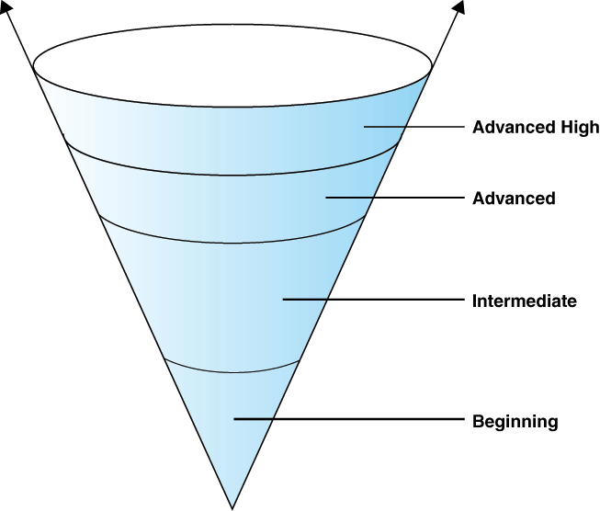
TELPAS Levels

Slide 22
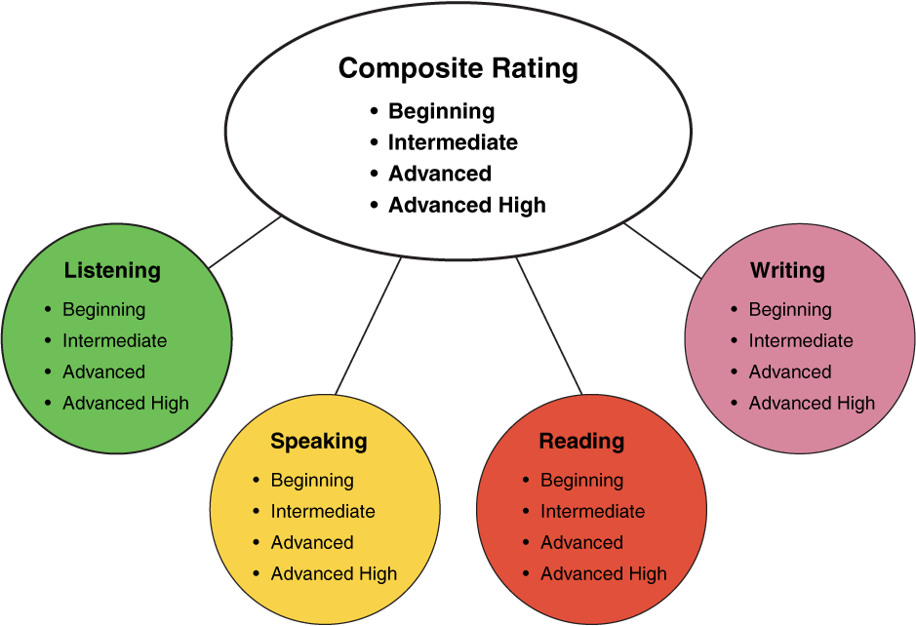
TELPAS Domains
25%
25%
10%
30%
25%
25%
10%
50%
2nd-12th Online

Slide 23
ELPS Resources
LIAG and ELPS Instructional Tool
+
DMAC Reports

Slide 24
ELPS Mingle!
Listening PLDs
Listening Expectations & CCRS
Listening Teacher Behaviors
Speaking PLDs
Speaking Expectations & CCRS
Speaking Teacher Behaviors
Reading 2-12 PLDs
Reading Expectations & CCRS
Reading Teacher Behaviors
Writing 2-12 PLDs
Writing Expectations & CCRS
Writing Teacher Behaviors

Slide 25
DMAC TELPAS Reports
How to Run TELPAS Reports by Language Domain
Go to Home Page
Go to State Assessment
Select TELPAS
Select Instructional Reports
Select Student Language Proficiency Rating
Generate Report

Slide 26
Sample DMAC Report

Slide 27
ELPS for Administrators
Go to: www.texasgateway.com
Sign Up: Create an account
Search: ELPS
Find: ELPS for Administrators
Complete course

Slide 28
ELPS Instructional Tool
Meeting the needs of beginning and intermediate ELLs

Slide 29
Session Objectives
Content Objective
Today examined how to implement the ELPS in all content areas and how to analyze TELPAS data to guide instruction.
Language Objective
Today shared (orally and in writing) different ideas on how to linguistically accommodate instruction with the ELPS based on TELPAS results.

Slide 30
Tickets Out
I used to think…
But now I know…

Slide 31
Thank you! See you 11/29!
Karina E. Chapa, M.Ed.
Language Proficiency, Biliteracy and Cultural Diversity Director
kchapa@esc1.net
Facebook: Region One ESC Bilingual
Twitter @esc1bilingual @bilingualpride

